Slide 1
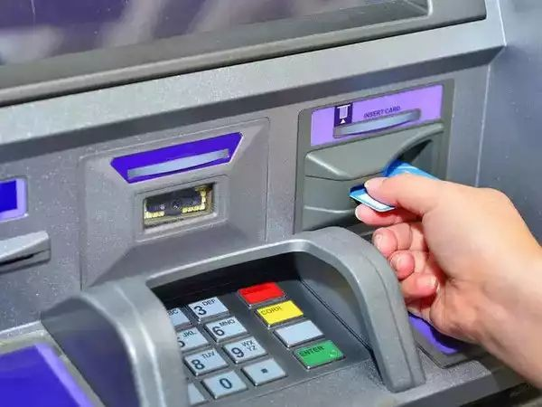
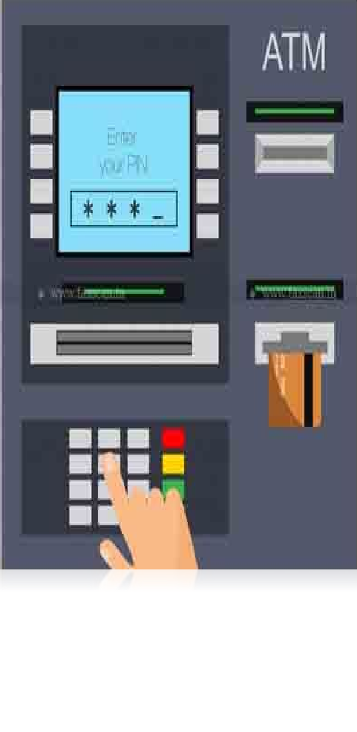
SECURING ATM TRANSACTIONS (CYBER SECURITY FOR CYBER PHYSICALSYSTEMS)
CHIRAG JAIN 18BIT0008
MAHAK GUPTA 18BIT0041
MUSKAN SAINI 18BIT0382

Slide 2
Abstract
Problem Statement Literature Survey Our Proposal Architecture
Project Report
Outline

Slide 3

Abstract
ATMs allow to make deposits and withdraw money and even you can print a statement, view your account balance and even transfer money between your accounts. ATMs, if properly secured, are safe and most convenient way to manage our money.
To protect our money and transaction we need to safeguard them from different type of attacks. Nowadays due to development in technology, new ATM machines are being built up with more and more security. But to destroy this security level, threats are being imposed. Regardless of enhancement in the automation, still ATM are prone to thefts and frauds.

Slide 4
The present ATM model uses a card and a PIN. This is a very simple ATM model and can easily be attacked. The attacks can in form of stolen cards, duplicity of cards or due to statically given PINS.
Problem statement
To improve the security of the ATM model, biometric technique was also introduced in which user has to give biometric ﬁrst and then after verifying he has to enter the PIN. This improved security but later it failed as there were different errors found in this technique.

Slide 5
Literature Survey
S.No. | Paper | Link | Journal | Authors | Abstract | Research Gap
1. | Enhanced | https://www.s | Procedia | Mohsin | Features like face | Retina recognition
 | security for | ciencedirect.c | Computer | Karovaliya, | recognition and | not yet
 | ATM machine | om/science/ar | Science Vol. | Saifali | One-Time Password | implemented due
 | with OTP and | ticle/pii/S1877 | 45 | Karedia, | (OTP) are used for the | to higher cost.
 | Facial | 05091500409 |  | Sharad Oza , | enhancement of security | Attackers can
 | recognition | 3 |  | D.R. | of accounts and privacy | intercept the OTP
 | features |  |  | Kalbande Dr. | of users. Face | as well so a
 |  |  |  |  | recognition technology | security measure
 |  |  |  |  | helps the machine to | against that was
 |  |  |  |  | identify each and every | not addressed.
 |  |  |  |  | user uniquely thus
 |  |  |  |  | making face as a
 |  |  |  |  | key.Moreover, the
 |  |  |  |  | randomly generated OTP
 |  |  |  |  | frees the user from
 |  |  |  |  | remembering PINs as it
 |  |  |  |  | itself acts as a PIN.

Slide 6
Literature Survey
S.No. | Paper | Link | Journal | Authors | Abstract | Research Gap
2. | A Review on | http://tmu.ac.i | International | Shivendra | ATM model can be | The flaws in face
 | Secure ATM by | n/college-of-c | Conference | Dwivedi, | developed that is more | recognition technique
 | Image | omputing-scie | on Advance | Ranjana | reliable in providing | like the inability to detect
 | Processing | nces-and-it/w | Computing | Sharma | security by using facial | face when beard, aging,
 |  | p-content/uplo |  |  | recognition | glasses and caps can be
 |  | ads/ |  |  | software.This type of | rectified and eliminated
 |  | sites/17/2016/ |  |  | security model can be | or reduced.
 |  | 10/ICAC-1604 |  |  | used to minimise ATM
 |  | 155.pdf |  |  | frauds

Slide 7
Literature Survey
S.No. | Paper | Link | Journals | Authors | Abstract | Research Gap
3. | Combating | http://citese | International | Adeniyi | The combined biometric | If the cost of retina or iris
 | Automated | erx.ist.psu.e | Journal of | Akanni, | features approach is to | recognition reduces, it can
 | Teller | du/viewdoc/ | Emerging | Oludele | serve the purpose both | be used.
 | Machine | download?d | Technology | Awodele | the identification and
 | Frauds | oi=10.1.1.44 | & Advanced |  | authentication that card
 | through | 5.2592&rep | Engineering |  | and PIN do. While iris
 | Biometrics | =rep1&type |  |  | replaces the card, fingers
 |  | =pdf |  |  | are used to do the
 |  |  |  |  | authentication.

Slide 8
Literature Survey
S.No. | Paper | Link | Journal | Authors | Abstract | Research Gap
4. | Biometrics and Smart Cards in Identity Management | https://pdfs. semanticsch olar.org/316 7/b3145a1a d762b8782b 34a99a2a88 bc84e05e.p df | Computer Security Journal | Bart Jacobs, Eric Poll
 |  |  |  |  | The card can protect the · When trying to match a information, it cannot stored biometric with one ^{easily be cloned, and even} freshly obtained, there is if a card is lost or stolen, _{always the chance of false} the protection it provides _{remains in place.} matches and false non-matches. Face Recognition:
 |  |  |  |  |  | between 2 and 10 persons out of 100 may not be verified.

Slide 9
Literature Survey
S.No. | Paper | Link | Journal | Authors | Abstract | Research Gap
5. | Facial | https://www. | American | Okereke, E. | A system which | 1. The proposed system
 | verification | semanticsch | Journal of | Ihekweaba, | incorporates facial | was not built as an
 | technology | olar.org/pap | Engineering | G. & | recognition technology into | improvement on the
 | for use in | er/Facial-Ve | Research | Okpara, | the identity verification | existing system. 2. The
 | ATM | rification-Te |  | F.K. | process used in ATMs was | study relied on
 | transactions. | chnology-for |  |  | proposed | open-source facial
 |  | -Use-In-Atm |  |  |  | recognition program and
 |  | -Eze/22915 |  |  |  | did not discuss the local
 |  | 640d7141a2 |  |  |  | features that will be
 |  | 7ea16a45f9 |  |  |  | analyzed for the facial
 |  | 16dda492ad |  |  |  | verification process
 |  | 1b3d3

Slide 10
Literature Survey
S.No. | Paper | Link | Journal | Authors | Abstract | Research Gap
6. | Improving | https://ww | International | Twum, | Increase the security and | Addition of fingerprint
 | Security | w.research | Journal of | Frimpong & | make the system more | might seem a good idea,
 | Levels In | gate.net/p | Emerging | Nti, Isaac | immune to attacks using | but it is an expensive
 | ATMs Using | ublication/ | Technology | kofi & | Multi-factor Authentication | process to implement
 | Multifactor | 30153650 | & Advanced | Asante |  | from scratch and there
 | Authentication | 0_Improvi | Engineering | Michael. |  | are multiple methods to
 |  | ng_Securit |  |  |  | forge a fingerprint.
 |  | y_Levels_I
 |  | n_Automat
 |  | ic_Teller_
 |  | Machines_
 |  | ATM_Usin
 |  | g_Multifact
 |  | or_Authent
 |  | ication

Slide 11
Literature Survey
S.No. | Paper | Link | Journal | Authors | Abstract | Research Gap
7. | ATM | https://www. | International | Onyesolu, | A fingerprint biometric | Transmitting the
 | Security | researchgat | Journal of | Moses & | technique is fused with the | fingerprint value to the
 | Using | e.net/public | Advanced | Ezeani, | ATM for person | authentication unit, the
 | Fingerprint | ation/26726 | Computer | Ignatius | authentication to ameliorate | encryption will take place
 | Biometric | 5597_ATM_ | Science & |  | the security level. | ambiguously as the pixel
 | Identifier: An | Security_Us | Application |  |  | values corresponding to
 | Investigative | ing_Fingerp |  |  |  | the fingerprint will not
 | Study | rint_Biometr |  |  |  | always correspond to the
 |  | ic_Identifer_ |  |  |  | same binary values each
 |  | An_Investig |  |  |  | and every time. Hence
 |  | ative_Study |  |  |  | any sort of man in the
 |  |  |  |  |  | middle attack will easily
 |  |  |  |  |  | get the fingerprint value
 |  |  |  |  |  | without even a
 |  |  |  |  |  | cryptanalytic attack.

Slide 12
Literature Survey
S.No. | Paper | Link | Journal | Authors | Abstract | Research Gap
8. | Towards | https://ww | ACM | De Luca | Field observations were | The limitation of the
 | understanding | w.research | International | Alexander, | performed in six different | survey are that to get the
 | ATM security - | gate.net/p | Conference | Langheinrich | locations in two central | info the users have to be
 | A field study of | ublication/ | Proceedings | , Marc, | European cities, Munich | disturbed from general
 | real world | 22116644 |  | Hussmann | (Germany) and Delft (the | course as it is not
 | ATM use | 2_Towards |  | Heinrich | Netherlands). We chose | collected from a specific
 |  | _understa |  |  | ATMs that were available | focus group and hence
 |  | nding_AT |  |  | 24 hours a day, seven | dependent upon many
 |  | M_security |  |  | days a week, and which | human factors.
 |  | _-_A_field |  |  | were located outside.
 |  | _study_of_ |  |  | This allowed for
 |  | real_world |  |  | unobtrusively observing
 |  | _ATM_use |  |  | actual ATM interactions

Slide 13
Literature Survey
S.No. | Paper | Link | Journal | Authors | Abstract | Research Gap
9. | "A New Vision for ATM Security Management”: The Security Management Platform | https://www. researchgat e.net/public ation/31243 5426_A_Ne w_Vision_fo r_ATM_Sec urity_Manag ement_The _Security_ Manageme nt_Platform per/f201403 211395407 076.pdf | 11th International Conference on Availability, Reliability and Security (ARES ) | Claudio Porretti, Denis Kolev, Raoul Laheije | A new vision for ATM Security Management that is proposed by the GAMMA project, and implemented by its “core” prototype called Security Management Platform. | Decision makers might find it too easy to accept vulnerabilities if mitigating them takes necessary resources from accomplishing a business objective

Slide 14
Literature Survey
S.No. | Paper | Link | Journal | Authors | Abstract | Research Gap
10. | Enhanced ATM Security using Biometrics | Oko, S. and Oruh, J. (2012): Enhanced ATM security system using | IJCSI International Journal of Computer Science Issues | Oko S. and Oruh, J | Developed an ATM based fingerprint verification and simulated it for ATM operations by incorporating the fingerprints of users into the bank‟s database | The system developed was inefficient because there was no finger print matching algorithm.
 |  | biometrics.
 |  | IJCSI
 |  | International
 |  | Journal of
 |  | Computer
 |  | Science
 |  | Issues,
 |  | September
 |  | 2012. Vol. 9,
 |  | Issue 5, No 3,
 |  | pp. 352-357.

Slide 15
Literature Survey
S.No. | Paper | Link | Journal | Authors | Abstract | Research Gap
11. | Enhancing ATM security using fingerprint and GSM technology | https://www. researchgat e.net/public ation/31548 3165_Enha ncing_ATM _Security_u sing_Finger print_and_G SM_Techno logy | International Journal of Computer Application | V. Padmapriya , S. Prakasam | A combination of fingerprint biometric token and GSM technology | A nominee or third party‟s finger print was incorporated in the architecture. There is a discord between the main user and the nominee user in the proposed system architecture

Slide 16
Literature Survey
S.No. | Paper | Link | Journal | Authors | Abstract | Research Gap
12. | Card duplication and crime prevention using biometrics. | https://www. researchgat e.net/public ation/27129 6818_Credit _Card_Dupli cation_and_ Crime_Prev ention_Usin g_Biometric s | IOSR Journal of Computer Engineering | Prithika M. | Proposed using the Iris Recognition and Palm Vein (IRPV) recognition technology to prevent card duplication and crimes via the ATM | a reliable scanner and registration device are not enough to create a trustworthy system The system is very expensive

Slide 17
Our Proposal
We propose a different and much more secure way of protecting ATM machine. In our proposed model, ﬁrst user enters the pin, this pin is encrypted using elgamal cryptographic algorithm and then the resulted output is given as input to SHA-512 Hash.
This is a secure way of transmission as it protects from man in the middle attack because if the attackers tries to decode, he will get only the hash value and will not be able to get the actual pin.

Slide 18
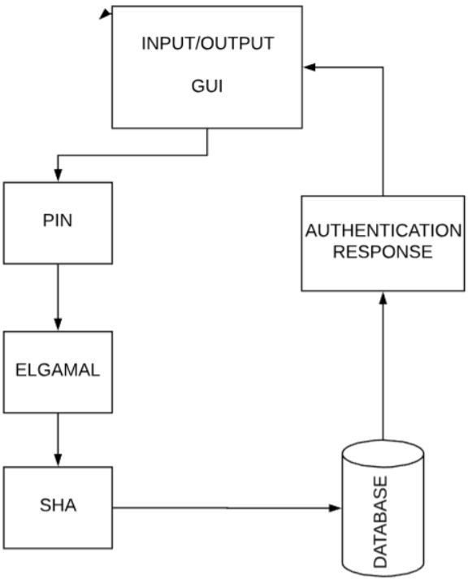
Architecture

